Slide 1
HIST 1302 U.S. History Since 1865

Slide 2
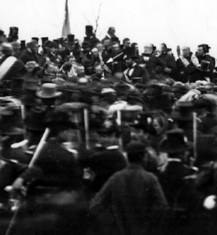
Gettysburg Address
A new founding document
Sacrifice
Reassert traditions
Lincoln delivers the Gettysburg Address

Slide 3
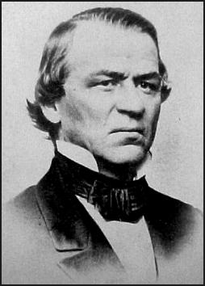
Presidential Reconstruction
Lincoln’s plan
Johnson’s reconstruction
Southern restoration
Andrew Johnson

Slide 4
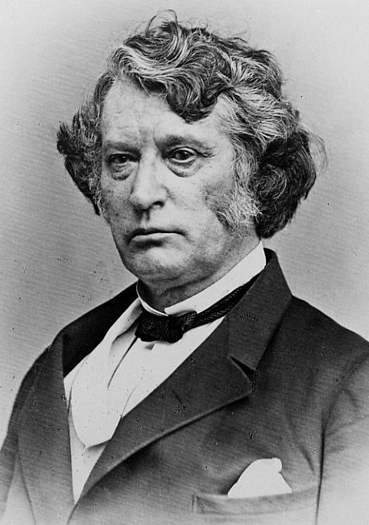
Congressional Reconstruction
Congressional resistance
Congressional domination
Constitutional reform
Charles Sumner of Massachusetts

Slide 5
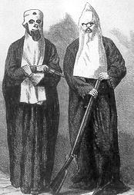
Southern Reaction and Redemption
Intimidation and violence
Southern reconstitution
The South redeemed
Ku Klux Klansmen, 1867

Slide 6
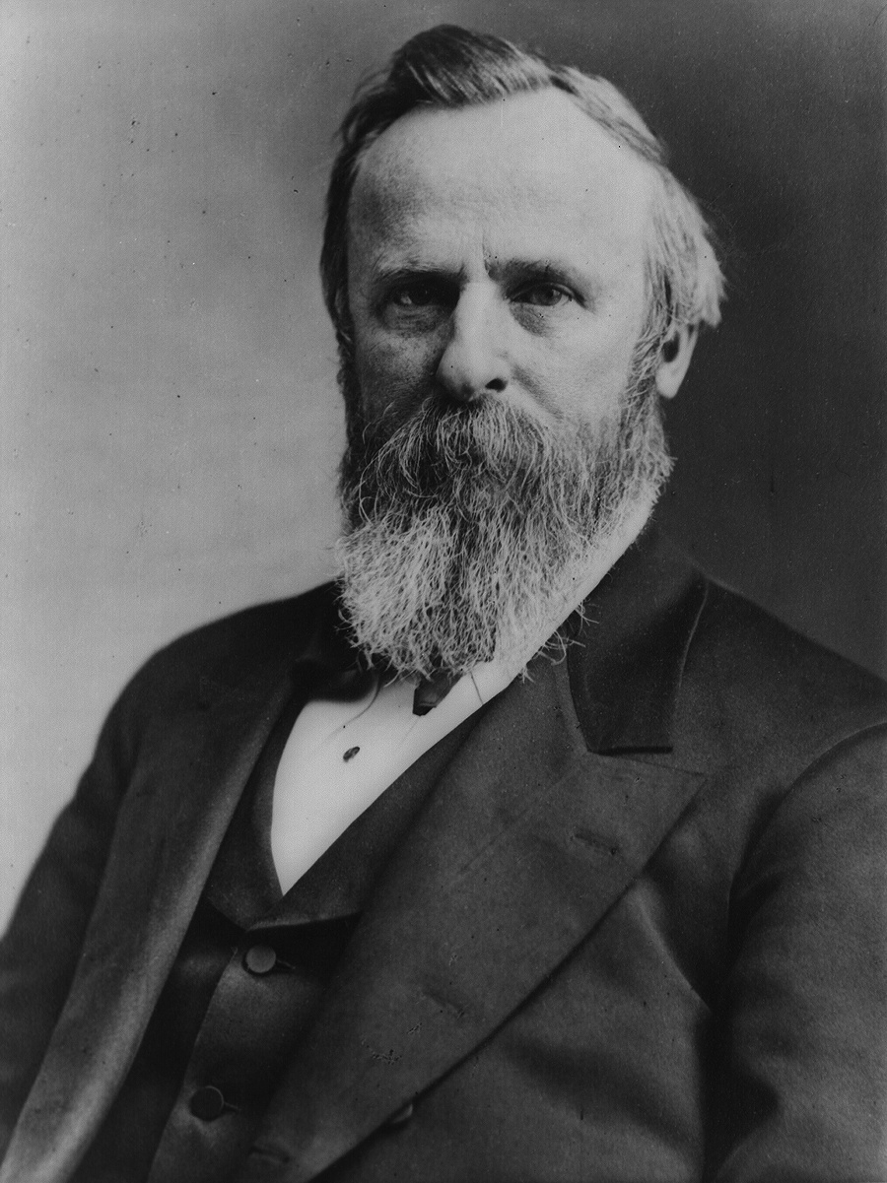
Compromise of 1877
National distractions
Election of 1876
Compromise
Rutherford B. Hayes

Slide 7
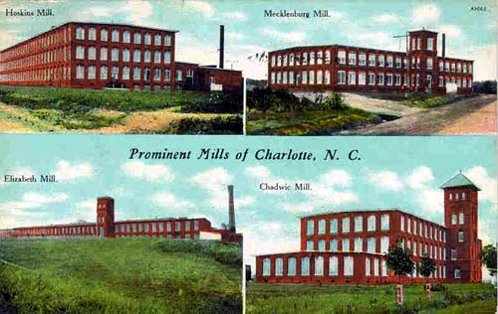
A New South
Boosterism
Abandonment of Southern Traditions
Industrialism

Slide 8
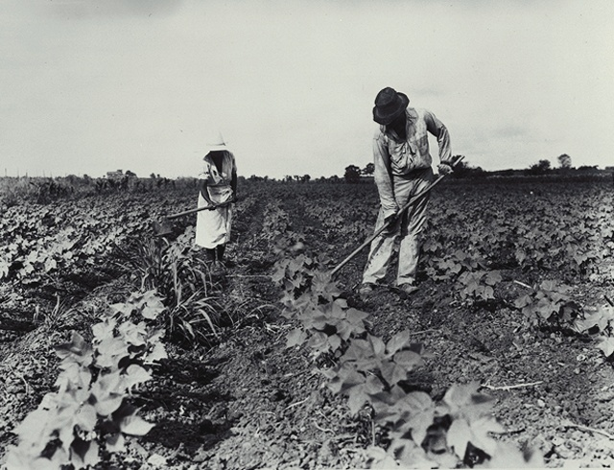
Southern Agricultural Tradition
Social hierarchy
Cotton tenant farming
Agriculture and government

Slide 9
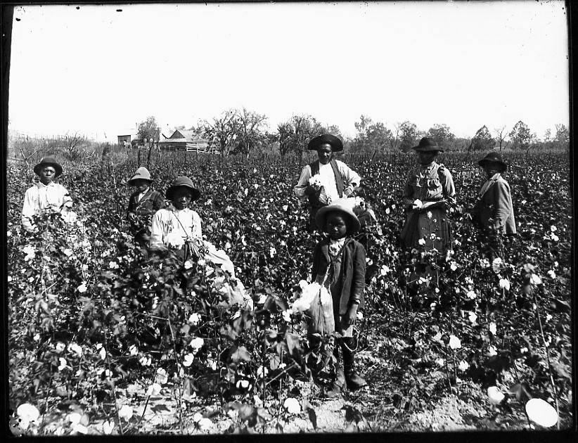
The New South
Old traditions
Emergence of new traditions

Slide 10
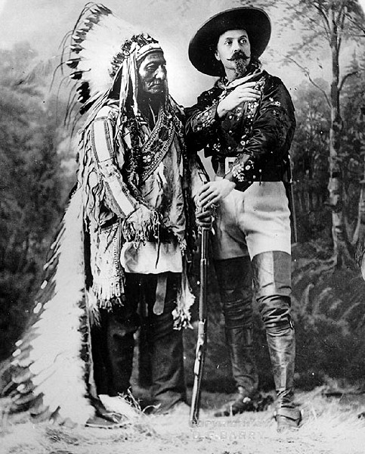
A New West
The West as East
The literary West
The many places of the West
Sitting Bull (Sioux) and Buffalo Bill Cody

Slide 11
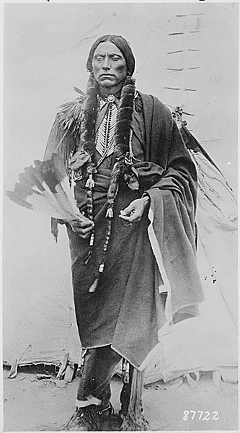
The Indians
Treaties and conflict
Reservations and assimilation
Resistance and the end of the frontier
Quanah Parker (Comanche)

Slide 12
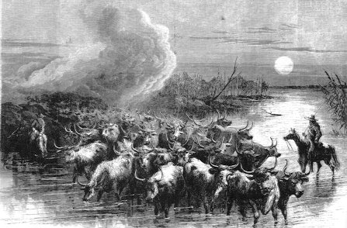
Opportunity and Western Settlement
Government incentives
Railroad incentives
The East and the West

Slide 13
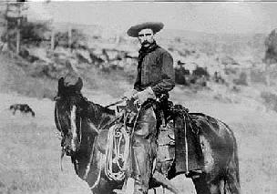
Eastern Traditions and the West
Western waste
A new frontier
A new national identity

Slide 14
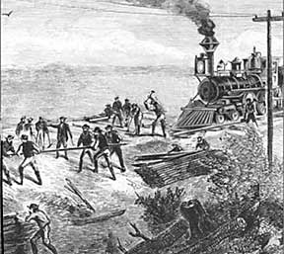
The Rails of Industrial Expansion
Expansion and integration
War as catalyst
Steel rails and expansion

Slide 15
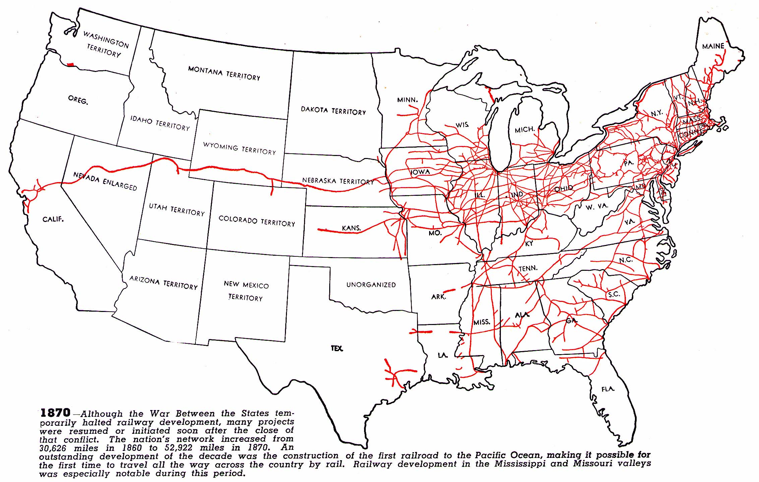

Slide 16
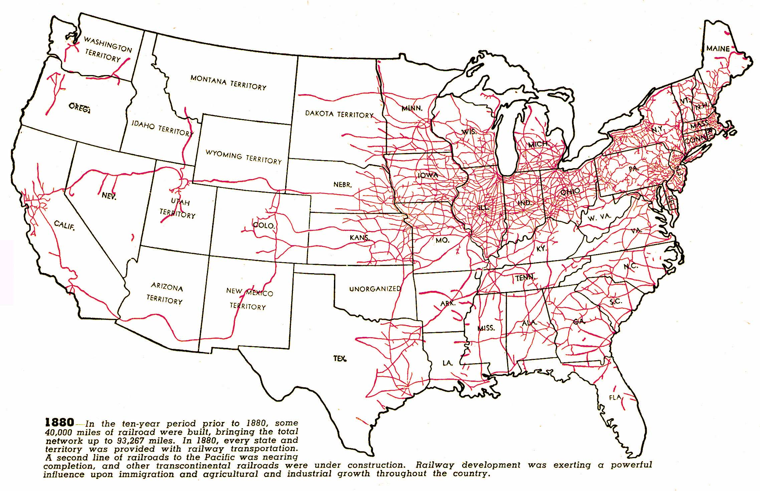

Slide 17
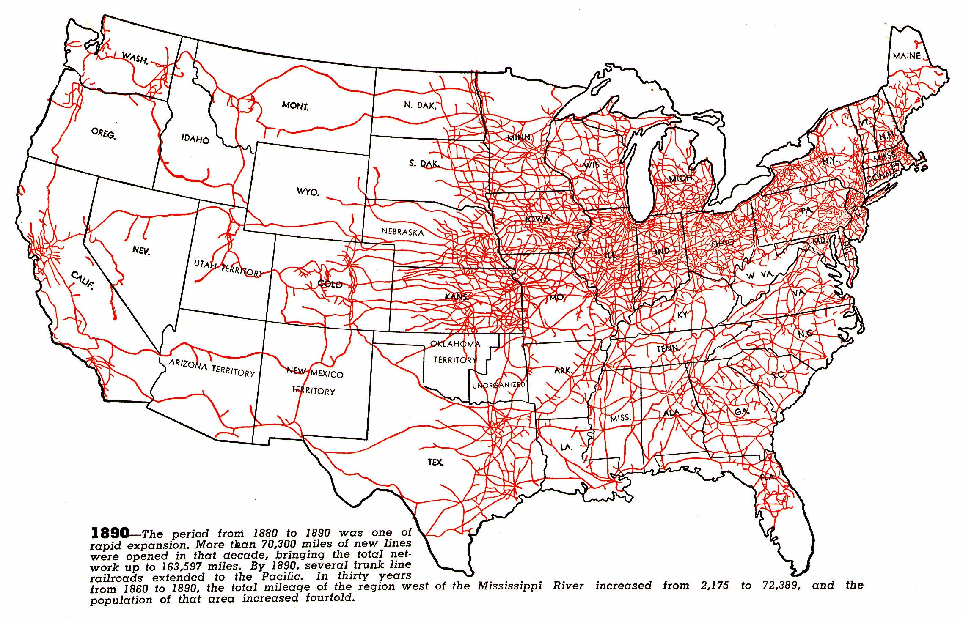

Slide 19
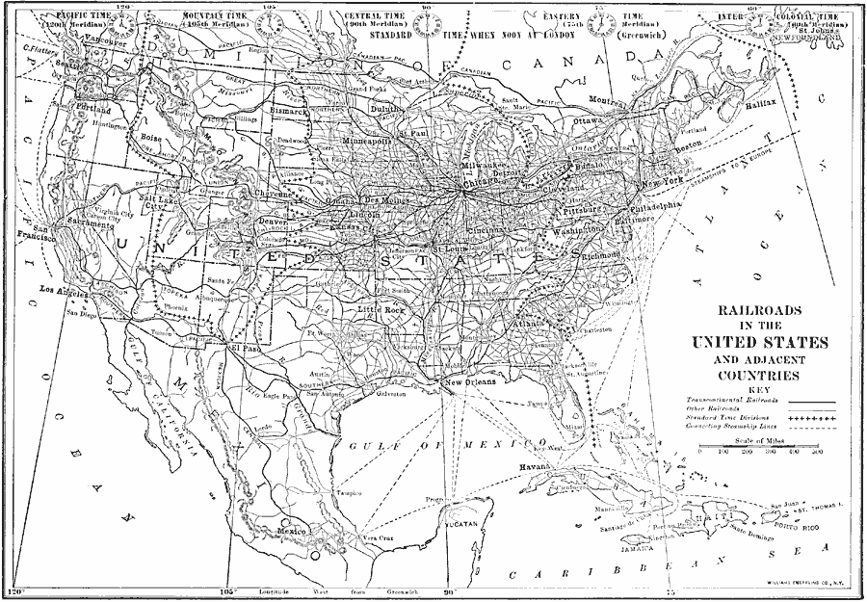

Slide 20
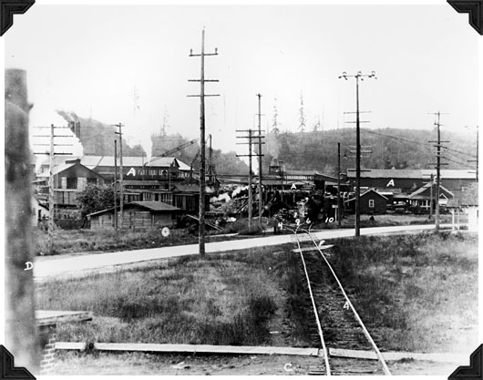
Railroads and Markets
Access to markets
Creation of markets
The retail market

Slide 21
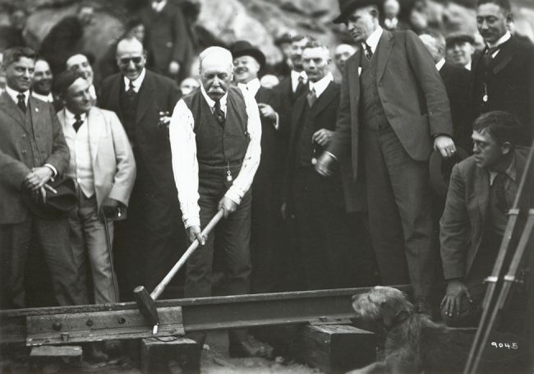
The First Big Business
An economy of scale
Management of cost and capital
Standardization and investment banking
Driving the Golden Spike

Slide 22
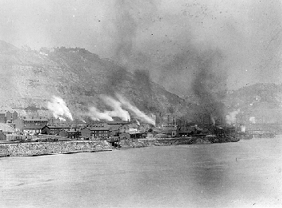
The Process of Industrialism
Early industrialism
An industrial revolution
Advertising
Steel Works near Pittsburgh

Slide 23
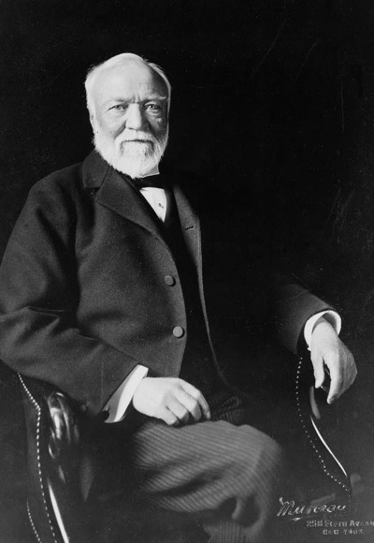
Responding to Competition
Vertical integration
Horizontal integration
Swift, Carnegie, and Rockefeller
Andrew Carnegie

Slide 24
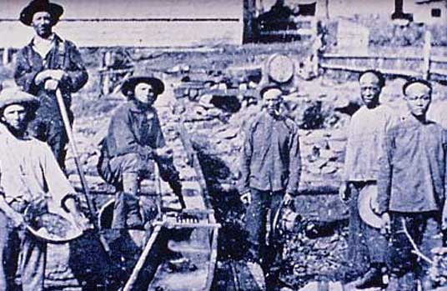
A New Economy, A New Nation
Common culture
Cooperation and economics
A double-edged sword
Miners in the West

Slide 25
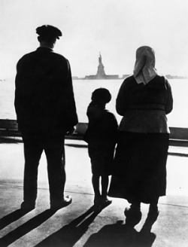
Immigration
Immigration and opportunity
Old and new immigrants
Reasons for immigration

Slide 26
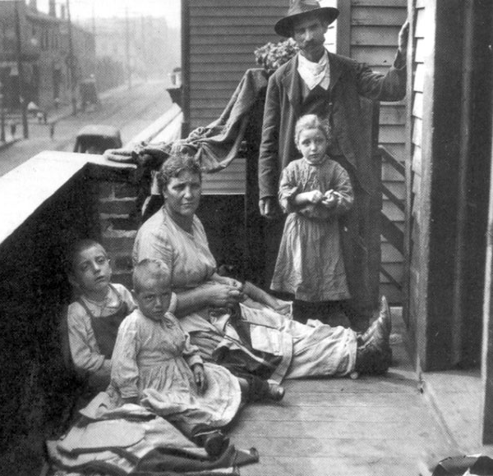
Immigrant Life
Immigrant society
Old and new traditions
Social issues
An immigrant family in Chicago

Slide 27
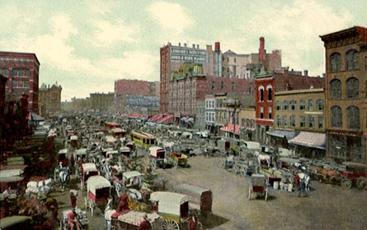
Urbanization
Population growth
Physical growth
Urban political reform
Chicago’s Haymarket Square, 1886

Slide 28
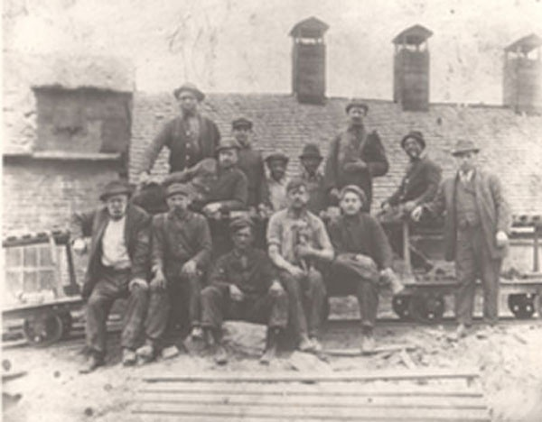
The American Labor Movement
The American labor tradition
Labor and industrial revolution
Steelworkers

Slide 29
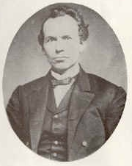
National Labor Union
Industrial workers’ interests
Economic reform
Politics and collapse
NLU Leader, William Sylvis

Slide 30

Knights of Labor
Brotherhood of workers
Labor issues
Collapse
Seal of the Knights of Labor

Slide 31
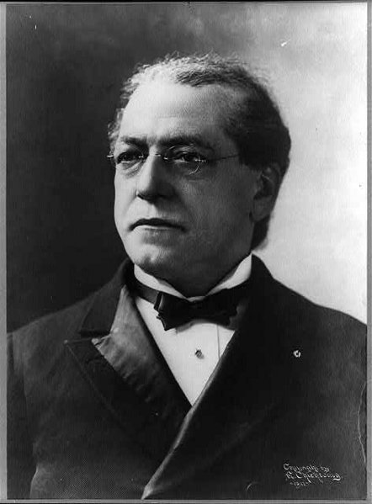
American Federation of Labor
Skilled workers’ union
Business unionism
Limits of AFL and union power
Samuel Gompers, AFL Leader

Slide 32
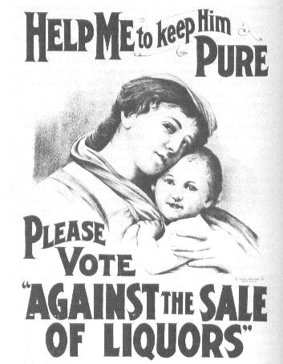
Early Reform
Pre-Civil War reform movements
Early Gilded Age moral reform
Early Gilded Age political reform
Prohibition Campaign Poster

Slide 33
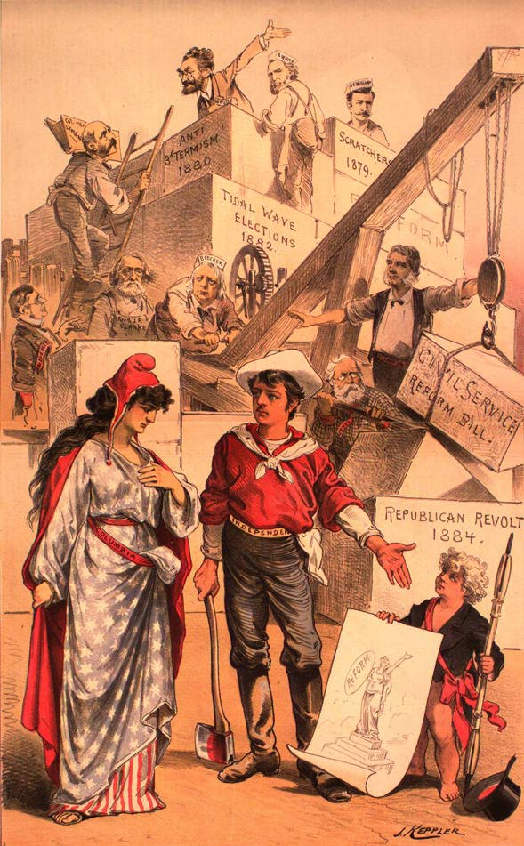
The Effect of Reform on Government and Politics
The growth of bureaucracy
The growth of government
Political realignment
Building Big Government

Slide 34
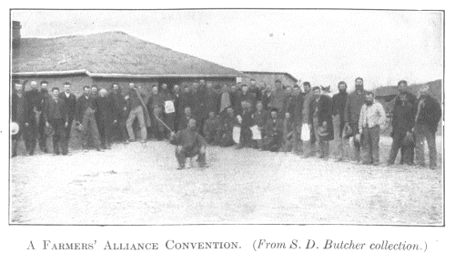
Farmers’ Revolt
Source of farmers’ problems
Farmers’ movements
The Peoples’ Party
A Farmers’ Alliance Convention

Slide 35
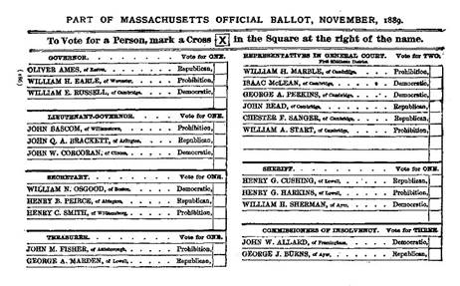
Politics Transformed in the 1890s
A reformed political process
Election of 1896
The new reformers
An Australian Ballot in Massachusetts, 1889

Slide 36
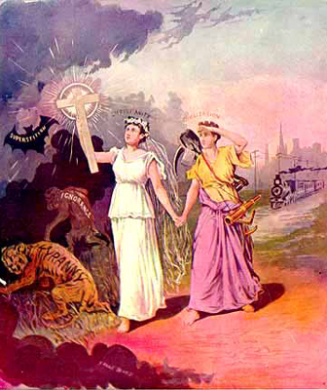
Foundations of Foreign Policy
Monroe Doctrine
Manifest Destiny
Reform
“Light of the World”

Slide 37
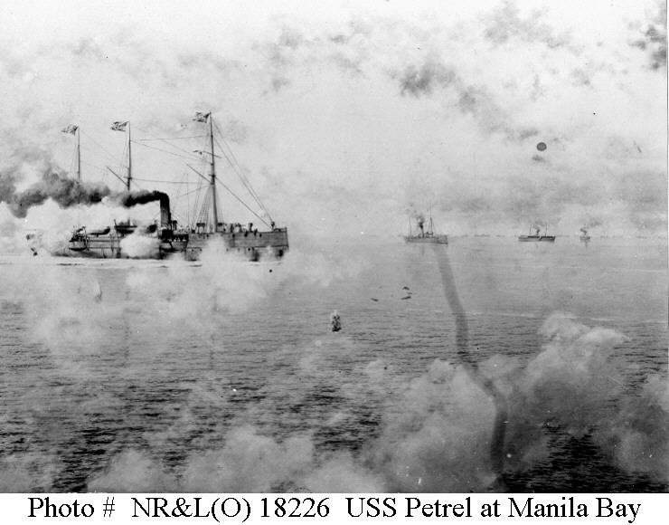
Expansion of Influence
The Pacific
Latin America
China

Slide 38
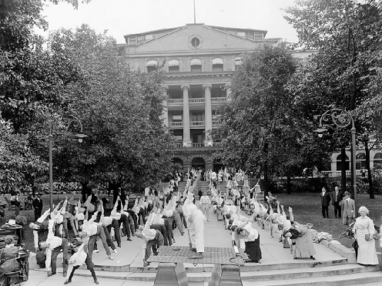
What is Progressivism?
Progress
Aim of Progressive Movement
Character of Progressivism
Calisthenics at a Sanitarium

Slide 39
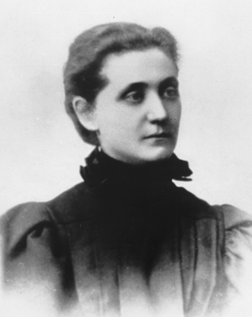
Local and State Reform
Settlement House movement
Urban reform
State administrative reform
Jane Addams

Slide 40
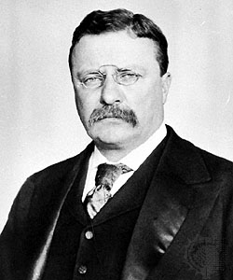
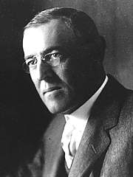
National Reform
Theodore Roosevelt
Woodrow Wilson
Government transformed
Roosevelt
Wilson

Slide 41
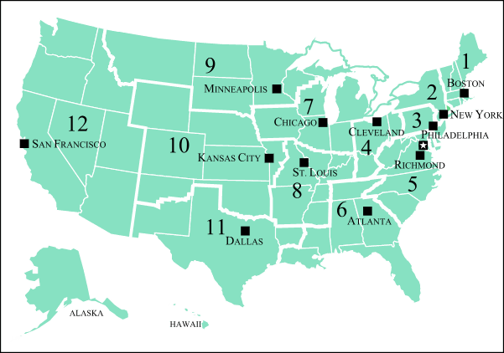

Slide 42
National Reform
Theodore Roosevelt
Woodrow Wilson
Government transformed
Roosevelt
Wilson

Slide 43
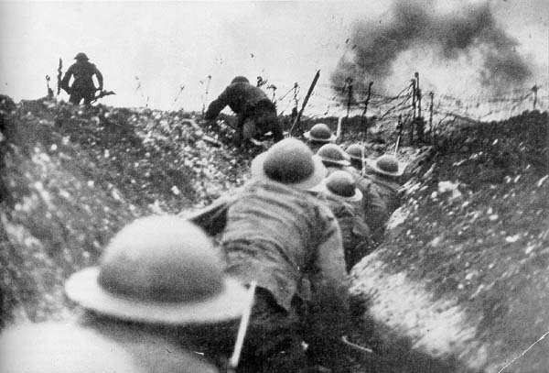
World War I
Progressive foreign policy
War in Europe
United States in World War I
Trench Warfare in France

Slide 44
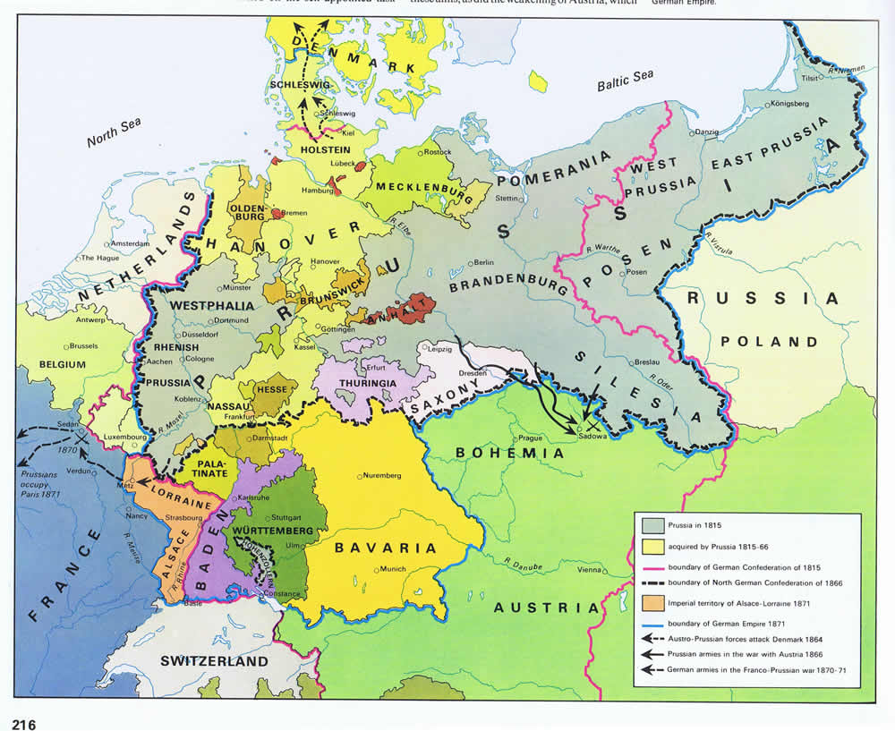

Slide 45
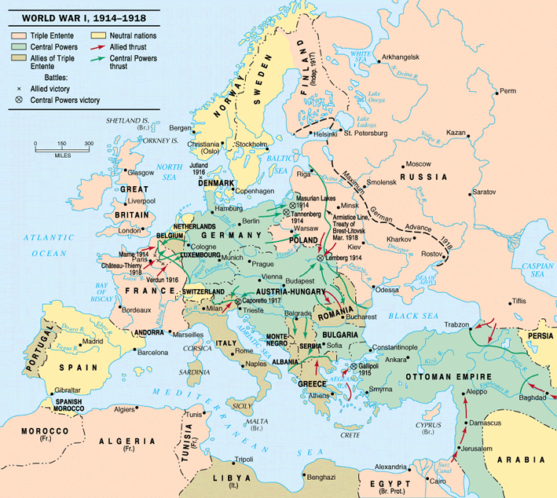

Slide 46
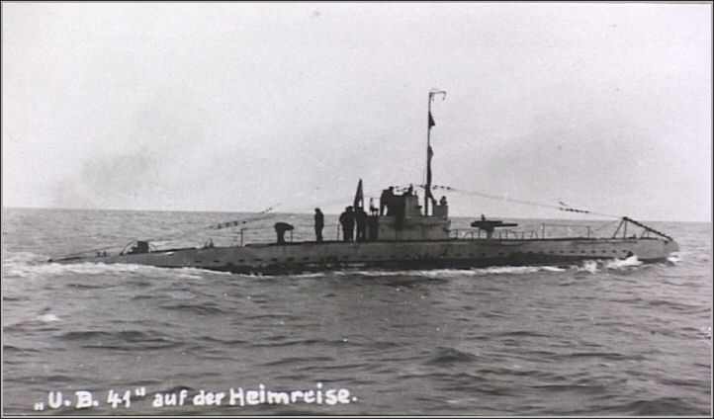
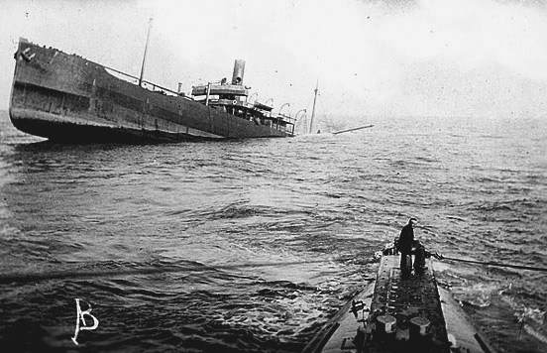

Slide 47
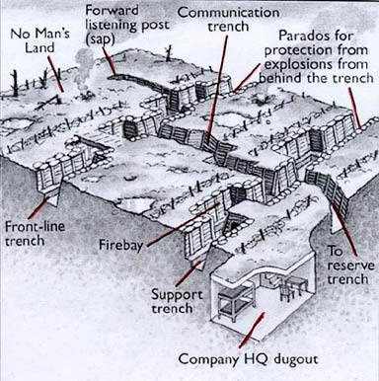
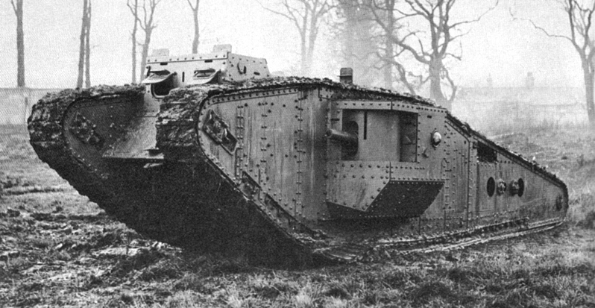
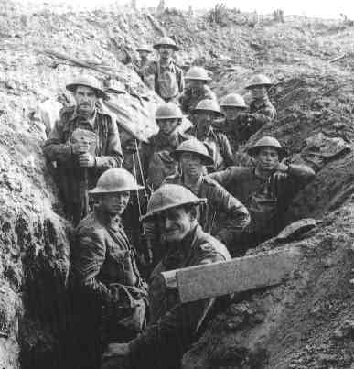
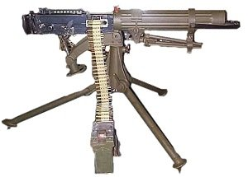

Slide 48
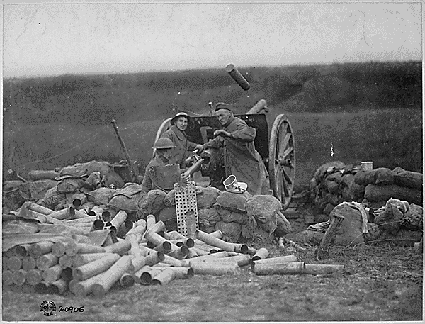
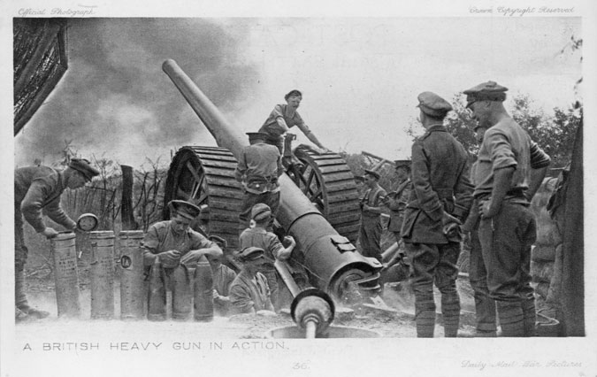

Slide 49




Slide 50



Slide 51

Social Effects of World War I
Black migration
Women
Americanization
Red Scare

Slide 52

Progressivism Triumphant
Prohibition
Women’s suffrage
Immigration
Confiscated Beer and Liquor

Slide 53

Return to Normalcy
Harding
Coolidge
Business progressivism
Calvin Coolidge and Walter Johnson

Slide 54

Collapse of Progressivism
Prohibition
Jazz
Reaction
Dixieland Jazz

Slide 55

Ku Klux Klan Day at the State Fair of Texas, 1923

Slide 56

Herbert Hoover and the Great Depression
Managed economy
Market boom and instability
Hoover’s progressive approach

Slide 57


Slide 58

Franklin Delano Roosevelt
Early life
Public life
Elected president

Slide 59

The First New Deal
Bank holiday
First Hundred Days
AAA and NIRA

Slide 60

The Second New Deal
Roosevelt swings left
Taxation, welfare, and unionism
Court packing

Slide 61

Legacy of the New Deal
Domestic economics
Regulation and Welfare
International trade and finance

Slide 62

The Rise of Nazi Germany
The effect of WW I
Fascism and Nazism
German expansion

Slide 63

The Rise of Imperial Japan
Post-WW I Japan
Japanese disarmament
Japanese expansionism

Slide 64

United States Isolationism
US internationalist heritage
Isolationism and neutrality
Emergence from isolationism

Slide 65


Slide 66


Slide 67

The Development of the Cold War
The end of WW II
European instability and U.S. foreign policy
Confrontation
Soviet Expansion of Influence

Slide 68


Slide 69


Slide 70


Slide 71

Containment Policy
United Nations
Containment
Tradition and the Cold War
George F. Kennan

Slide 72

Korea and the Cold War
China
Korean War
Stalemate
Fighting the Korean War

Slide 73


Slide 74


Slide 75

Brinksmanship
President Eisenhower
Attitude toward war
Brinksmanship
John Foster Dulles with President Eisenhower

Slide 76

The Politics of Anticommunism
FDR and the New Deal
Anticommunist legislation
Political inquisition
Senator Joseph McCarthy

Slide 77

Eisenhower as President
Dwight D. Eisenhower
President Eisenhower
Eisenhower’s style

Slide 78

Postwar Economic Growth
Growth
Government and the economy
New economic developments

Slide 79

Suburbia and Consumerism
Suburbanization
Effects of suburbanization
Consumerism

Slide 80

TV and Popular Culture
Increase in use
Homogenization
Values and culture

Slide 81

Early Civil Rights Movement
Civil War
Civil Rights Act of 1866
Reconstruction Amendments

Slide 82

Reassertion of Southern Tradition
Redemption
Jim Crow
Lynching

Slide 83


Response to Jim Crow
Booker T. Washington
W.E.B. DuBois
Washington
DuBois

Slide 84

Early Civil Rights Activism
Northern migration
NAACP
A. Philip Randolph
CORE
A. Philip Randolph with Eleanor Roosevelt

Slide 85

Postwar Civil Rights Movement
Truman and civil rights
Eisenhower and civil rights
Brown v. Board of Education

Slide 86

Civil Rights Movement in the 1950s
Montgomery Bus Boycott
Little Rock
Civil Rights Act of 1957
Sit-in movement
Martin Luther King, Jr.

Slide 87

Civil Rights Movement to 1965
JFK and civil rights
Freedom Rides and Birmingham
March on Washington
Civil Rights and Voting Rights Acts

Slide 88

John Fitzgerald Kennedy
Joseph Kennedy
JFK background
Accomplishments
JFK on PT-109

Slide 89

JFK as President
Liberal consensus
Domestic issues
Foreign policy issues

Slide 90

The Kennedy Style
The best and the brightest
Jacqueline Kennedy
The tragic end of Camelot
Jacqueline Bouvier Kennedy

Slide 91

LBJ’s Background
Texas
Politics
President

Slide 92

LBJ’s Presidency
The Kennedy Legacy
The Great Society
The War on Poverty

Slide 93

Vietnam
Initial involvement
Escalation and stalemate
Protest and disengagement
Marines Fighting at Hue during Tet Offensive

Slide 95

Election of Nixon
Silent majority
Southern strategy
Unity

Slide 96

Nixon’s Domestic Policy
New Federalism
Government programs
Economics

Slide 97

Nixon’s Foreign Policy
Vietnam
China
Soviet Union

Slide 98

The Demise of the Left
Draft resistance
Factionalism
Counterintelligence
Appeal to middle-America

Slide 99

Watergate and the Erosion of Executive Authority
CREEP
Investigation
Resignation

Slide 100

Gerald Ford
Domestic policy
Foreign affairs
Presidential politics
Nixon and Ford

Slide 101

James Carter
Domestic policy
Foreign affairs
Presidential politics

Slide 102

Ronald Reagan
Domestic policy
Foreign affairs
Presidential politics

Slide 103

George H.W. Bush
Domestic policy
Foreign affairs
Presidential politics

Slide 104

Bill Clinton
Domestic policy
Foreign affairs
Presidential politics

Slide 105

George W. Bush
Domestic policy
Foreign Affairs
Presidential politics

Slide 106

Barack Obama
Domestic policy
Foreign Affairs
Presidential politics

