Slide 1

Social Behavior, Kinship Behavior, Culture, Tradition, and Ethnicity
Lyle Steadman

Slide 2
Social Behavior and Sacrifice
Social behavior distinguished by ancestral sacrifice
Sacrifice is aimed at promoting the interest of another
Sacrifice selected for as kinship behavior
Extend sacrifice to distant kin
Social behavior is subject to selection

Slide 3

Social Behavior
Defined as sacrifice
Promoting another’s interest at the expense of one’s own
Must favor reproduction from a evolutionary perspective

Slide 4
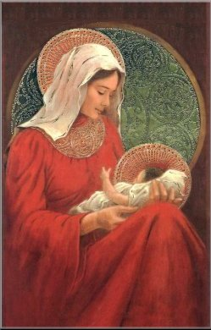
Parental Care
Favors child at the expense of the parent
Ancestral strategy
K vs. r
Females as basis of social behavior

Slide 5
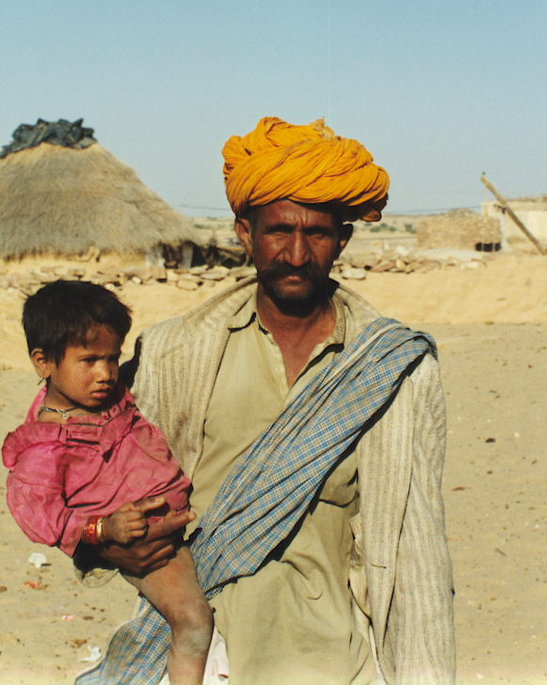
Kinship Behavior
Basic social behavior among mammals
Terms derived from kinship
Kinship model encourages social behavior

Slide 6
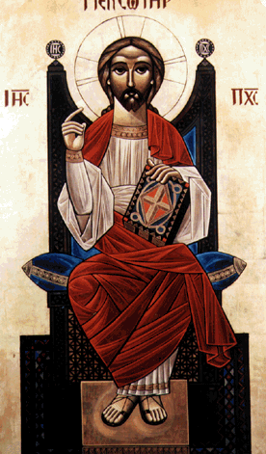
Religion and Social Behavior
Promotes kinship behavior
Encourage sacrifice
  Taboos
  Rituals
Ancestral descendant leaving success
Ancestral influence on later generations

Slide 7
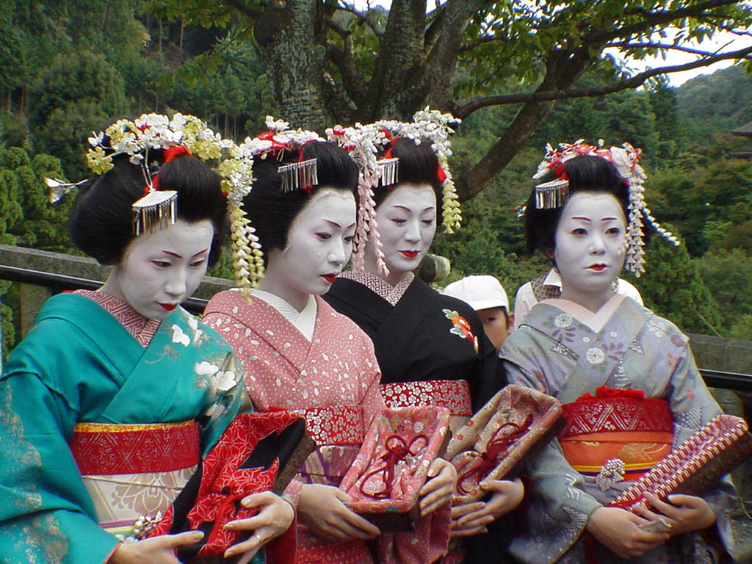
Natural Selection and the Evolutionary Status of Culture
Natural selection
Traditions are influenced by selection
What is tradition?
Traditional Japanese kimonos

Slide 8
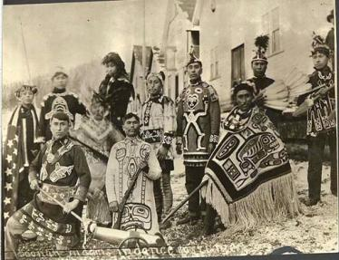
Culture and Traditions
Culture
Ancestral knowledge and influence
Traditions, natural selection, and heritability
Tlingit Indians in Alaska

Slide 9
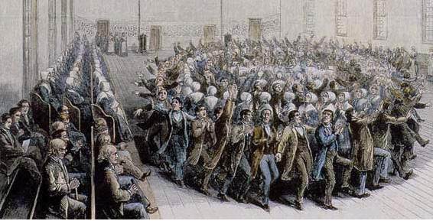
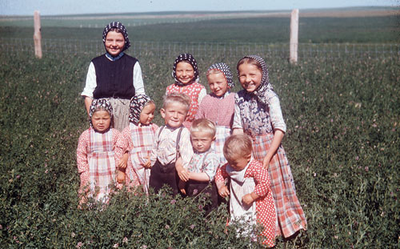
Shakers and Hutterites
Shaker customs go extinct
Hutterite traditions increase

Slide 10
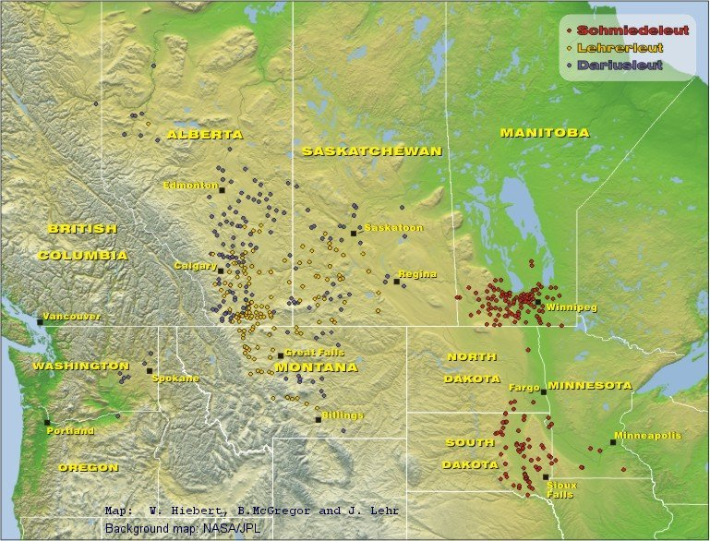
Hutterite colonies in the United States and Canada

Slide 11

Kinship, Religion, and Ethnicity
Examines the relationship between kinship and ethnicity by focusing on religious traditions

Slide 12
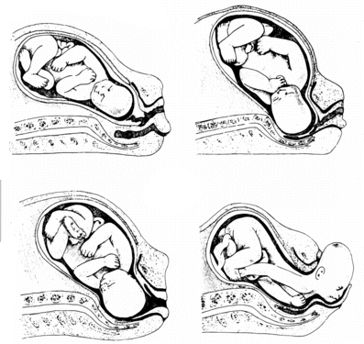
Kinship Relationships
Kinship
Kinship behavior
Identifying genealogical distance

Slide 13

Ethnicity
Distant genealogical relationships
Assumption of common ancestry
Basis of both types of discrimination

Slide 14
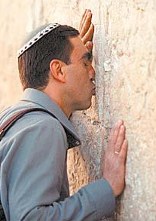
Religion and Ethnicity
Encourages altruism
Use of kinship terms and rituals
Religious origin of ethnicities

Slide 15


Slide 16
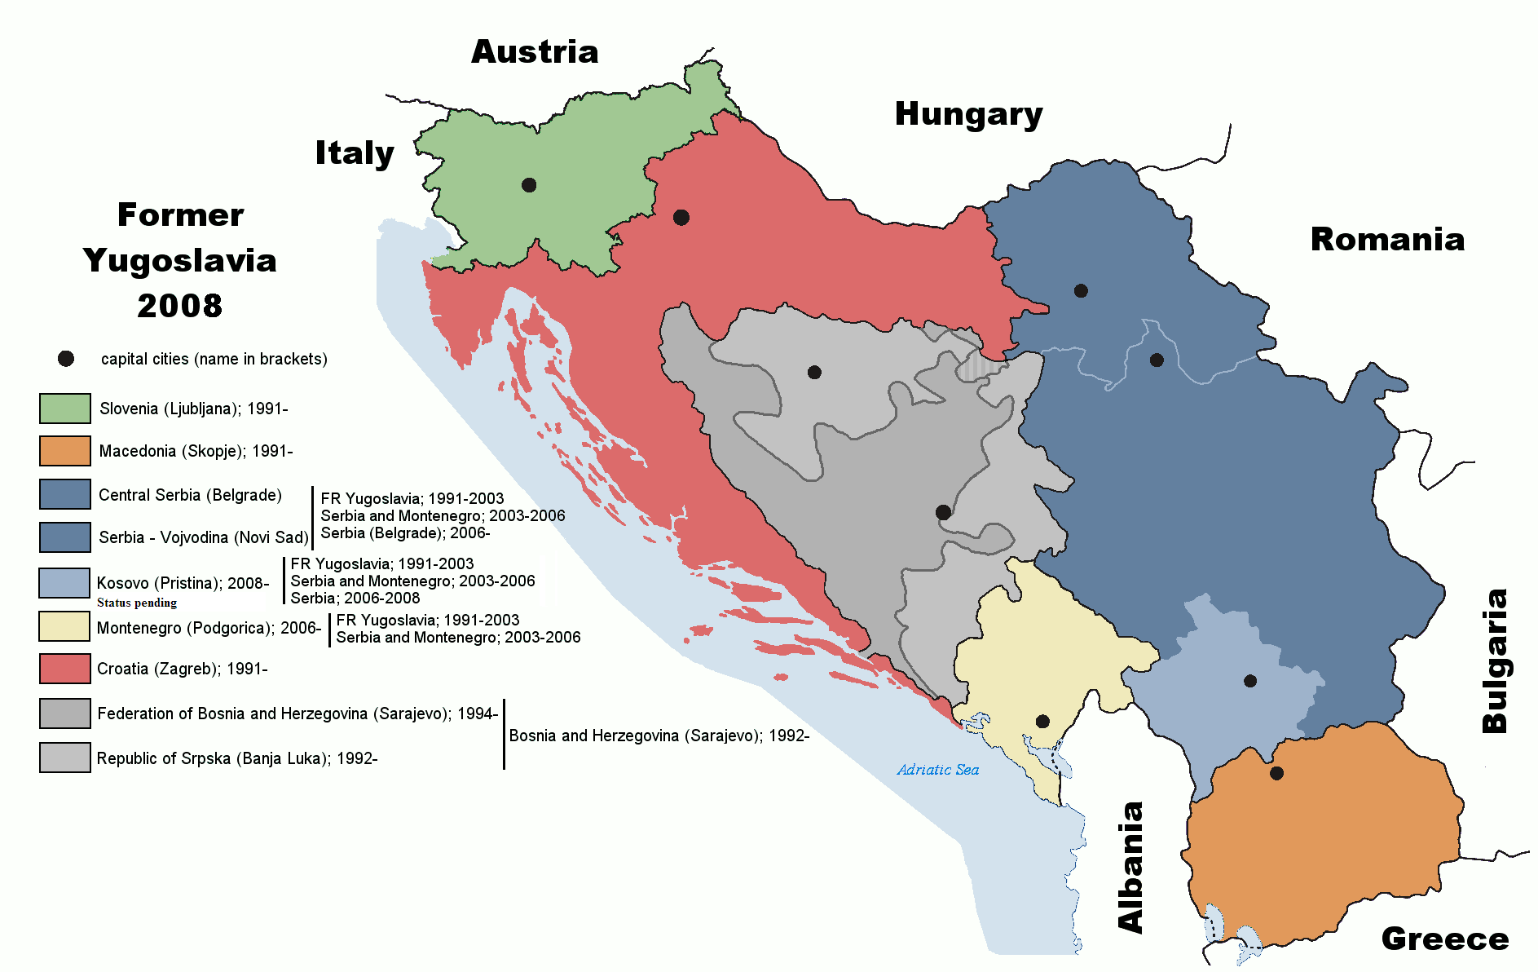

Slide 17
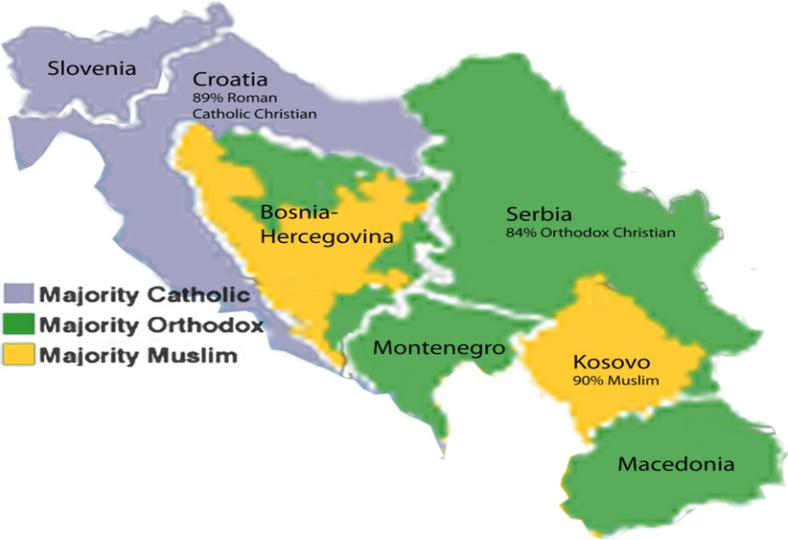

Slide 18
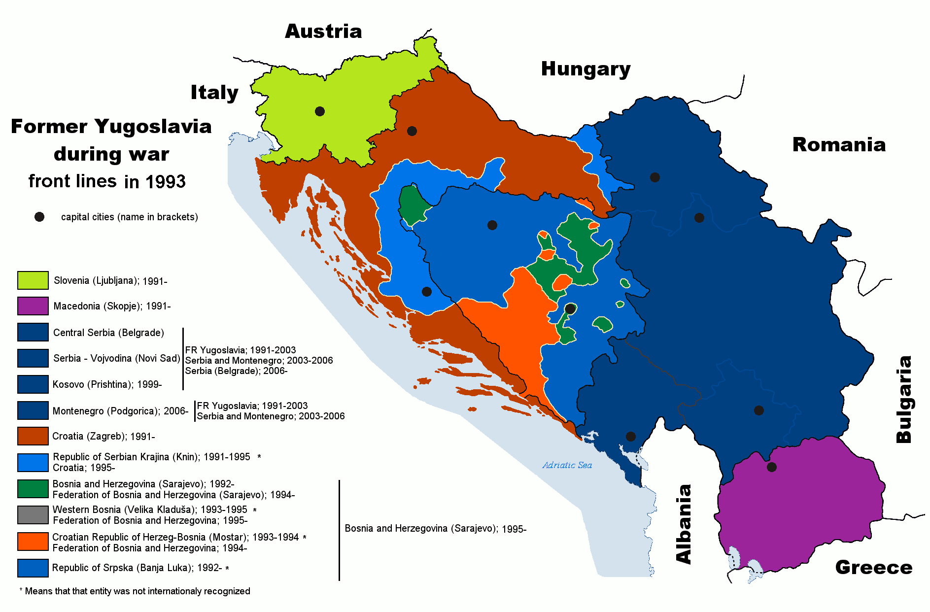

Slide 19
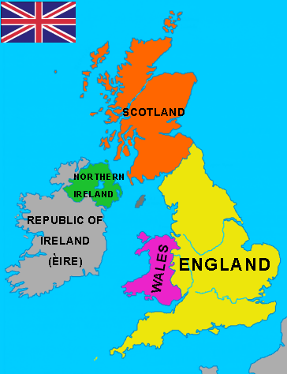

Slide 20
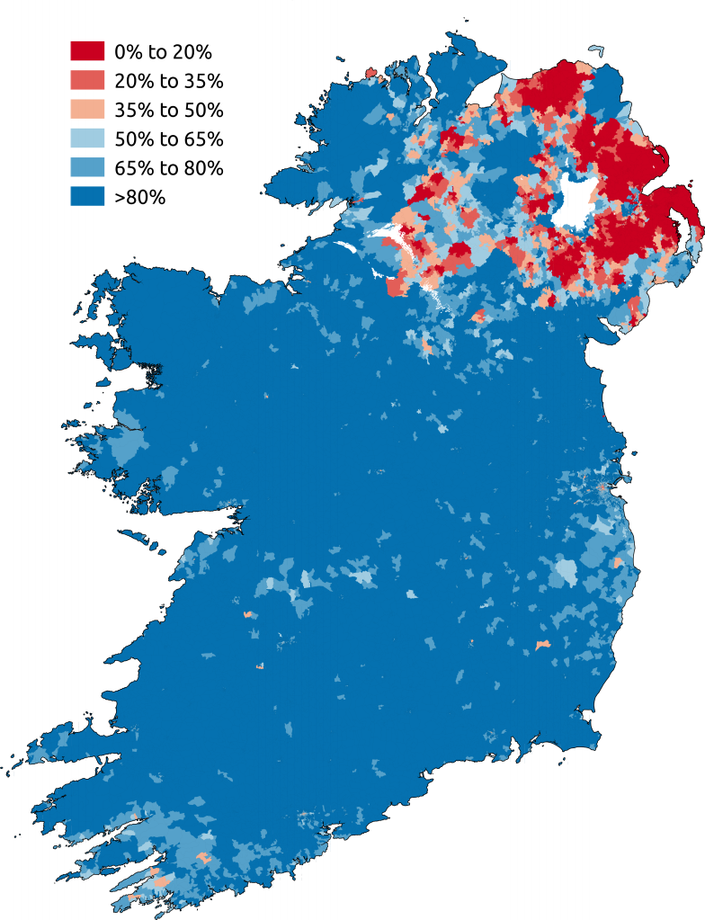

Slide 21
