Slide 1
The Nature of History

Slide 2
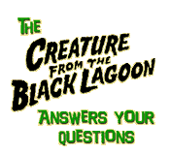
A Common Questions Asked About the Nature of History
Why do humans have history?
  What is history?
  Where does it come from?
  Do Only Humans Have History?
Notes:
A common question that historians and philosophers of history ask:
Why do humans have history?
In response to this question I would ask:
Do only humans have history?
Don’t dogs have history?
What, then, is history?
Where does it come from?

Slide 3
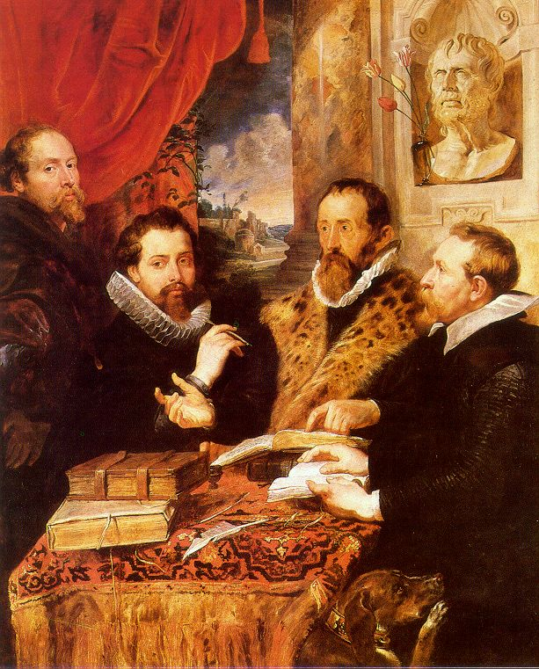
Why Do Humans Have History?
Some have suggested:
  we have history to help us to know why we have lived
  is this necessarily important?
Notes:
Many historians have suggested that humans have history because it helps us figure out why we have lived.
Is knowing why we have lived necessarily important?
As far as we know, dogs don’t know why they have lived but they continue to live, reproduce, and persist.
We do know that dogs have history.
So, why don’t dogs want to know their history, or why they lived?
How do we know that dogs can know their past?
Dogs can recognize someone who treated them wrong in the past.
Dogs have history but they don’t practice or study their history like humans do.
Unlike humans, dogs have not evolved the necessary biological and cultural mechanisms to study history even though humans and dogs share 90 to 95% of their genome.
So, there is something distinct that defines humans as opposed to dogs.

Slide 4
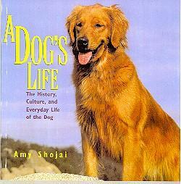
Dogs and History
Dogs Exist
Dogs Have History
There is something that distinguishes humans from dogs

Slide 5
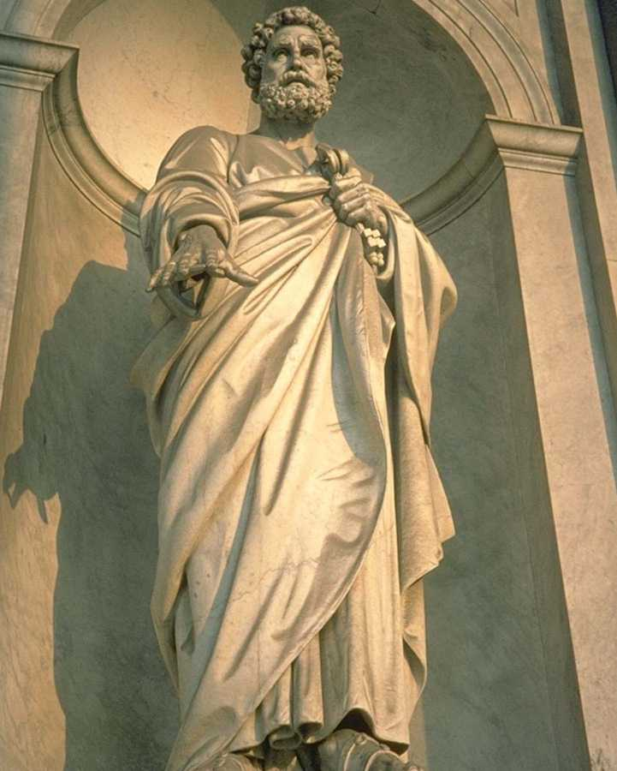
Human Uniqueness
Humans study History
Something defines humans
The roots of history
Notes:
I think that the answer to the question why do humans have history? can be found by first understanding what humans are and humanity is.
One common definition for humanity states that:
humanity is defined by its uniqueness, especially in its cumulative ability to create change.
The term cumulative means growing by accumulation or successive additions, and people probably use this word in the definition of humanity to suggest progress.
Another way historians often define humans is by pointing out that we live in complex ways called culture, and that culture is progressive.
Unfortunately these definitions are wrong.
WHY

Slide 6
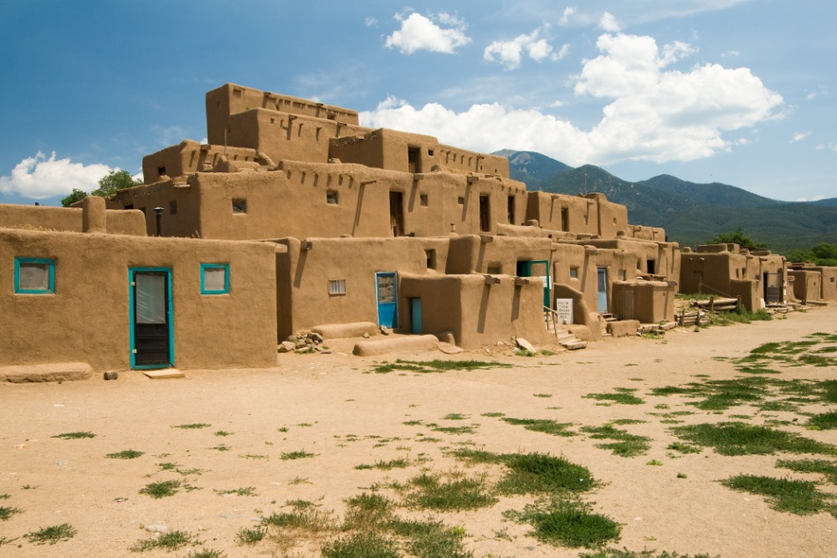
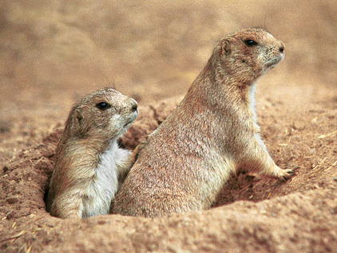
A Definition of Humanity?
Cumulative change
Definition is wrong
Connotation

Slide 7

Definitions and Knowledge
Definitions
  Connotation
  Denotation
Knowledge and scholarship
Verifiable propositions
Notes:
The definition of cumulative ability to create change is ultimately wrong because it is connotative.
Connotation is a meaning associated with a word, but not what you need to know to use it properly.
For example, because prairie dogs and asteroids also have the cumulative ability to create change then this cannot be the definition of humanity.
The definition a cumulative ability to create change therefore can refer not only to humanity but to dogs and asteroids as well.
The definition, a cumulative ability to create change, can be associated with humans, but since it can also be applied to other things it is not necessarily what we need to use the term properly.
To define a term we need to determine the denotation of that term.
Denotation is the essential meaning of a given word. What you necessarily need to know in order to use it properly.
Definitions should establish the denotative nature of a word.
Because definitions are logical propositions, they are not arbitrary.
As propositions, they have meaning if their referents are verifiable by observation.
Therefore, definitions are testable hypotheses stating the necessary and sufficient conditions for the referent of any given term.

Slide 8

Denotative Definitions
Testable hypotheses
Necessary and sufficient
  Clouds
  Exercise
Observation and meaning

Slide 9
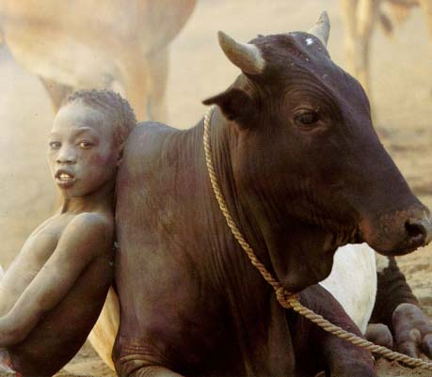
An Example of Denotation
Pastoralism:
  Ownership
  Reproduction
  Inheritance
  Product use
A young cattle pastoralist in East Africa

Slide 10
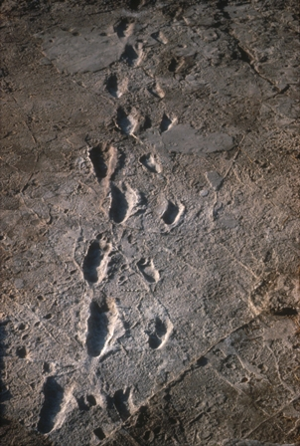
Another Definition of Humanity?
Culture
Complexity and progress
Beyond nature?
Fossilized Human Footprints in Africa
Notes:
Another way historians often define humans is by pointing out that we live in complex ways called culture, and that culture is progressive.
First of all this is problematic because don’t other creatures live in complex ways and also have culture (eusocial insects bees and ants).
According to many, human culture has been built by humans conscious choice as well as naturally.
This way of thinking suggests that human cultural behavior was originally forged by natural selection, but it also suggests that conscious choice has liberated humans from the effects of nature on our cultural development.
In other words what this approach is saying that one day a man consciously decided to be outside or beyond nature.
Many historians and social scientists often separate humans from nature, therefore making humans essentially supernatural or beyond nature.
IS THIS POSSIBLE?

Slide 11
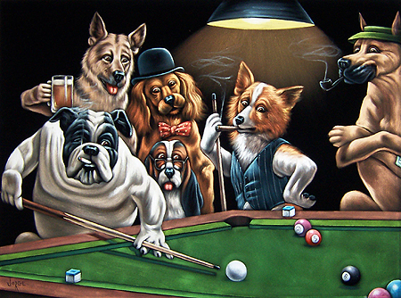
Five General Misunderstandings
Natural Selection
Social Behavior
Kinship Behavior
Culture and Tradition
What distinguishes Humans from other Animals

Slide 12
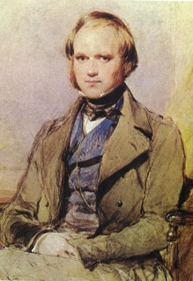
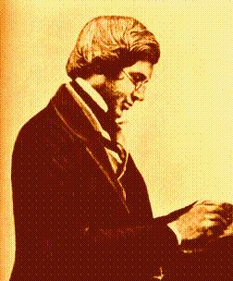
Natural Selection
Darwin and Wallace
Discovery of logic
Hypothesis of natural selection
Alfred Wallace
Charles Darwin
Notes:
To begin to understand what distinguishes humans from other animals (especially mammals) we first need to understand what natural selection is.
Natural selection is the influence of inheritable and replicable traits on their own frequency in later generations.
Why traits and not just genes?
When Charles Darwin and Alfred Russell Wallace independently discovered natural selection neither men knew about genes.
Gregor Mendle, the discoverer of genes, had sent Darwin a letter informing him of his discovery, but Darwin never read it.
Darwin did not understand the biological mechanisms of evolution, but he didn’t need to.
An understanding of genes is not necessary to understand that inheritable traits (shape of birds beaks) have influence on their own frequency.
You don’t necessarily need to know the chemical properties of aspirin to know that it helps relieve the pain of a headache.
Genes became focused on by scientists around the turn of the century (1900) when Mendle’s work was rediscovered.

Slide 13
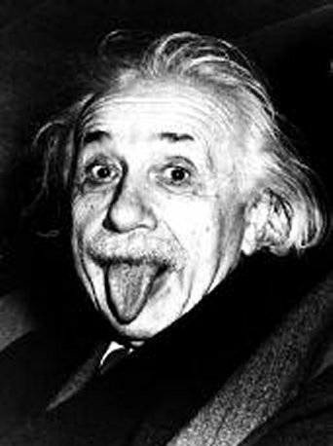
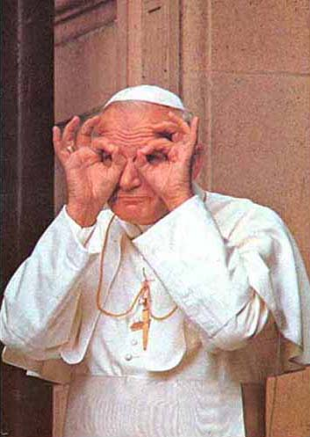
Science and Religion
Not Exclusive
Science
  Nature
Religion
  Supernatural
Albert Einstein
Pope John Paul II

Slide 14
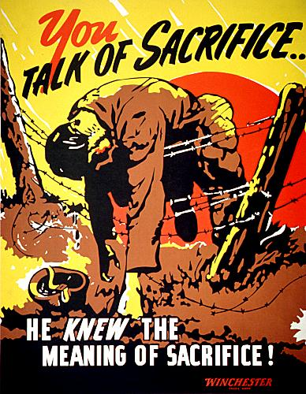
Social Behavior
Implies sacrifice
Doesn’t imply Groups or Interaction
Requires Helping at One’s Expense
Poster from World War II
Notes:
Understanding the trait of social behavior provides further clues towards discovering what distinguishes humans.
Social behavior implies sacrifice.
Most people think that social behavior implies either a group or some kind of interaction between individuals. (Sociology is the study of groups)
But social behavior implies neither.
Mother’s behave socially to their young regardless of their belonging to a group or not.
And, although social behavior does imply two or more individuals, it does not imply interaction, because an individual can help another who does not realize it.
(Anonymous contributions to charities, charitable foundations [Carnegie], covering someone with a blanket while sleeping.)
Also interaction itself doesn’t imply social behavior.
Enemies fighting in a war is interaction but it is not social behavior.
Social behavior requires one individual helping another at their own expense.
From the perspective of natural selection that expense is survival and reproduction.
This is known as social selection.
Parental care is the perfect example of social behavior, because it reduces the parents own chance of survival and reproduction in favor of helping (sacrificing) for the survival and reproduction of the offspring.
Cooperation is also an example of social behavior in that it requires all cooperating individuals to make themselves vulnerable to (and possibly taken advantage of) by another.
In other words when you cooperate with someone you sacrifice selfish interests in favor of the other individual.

Slide 15
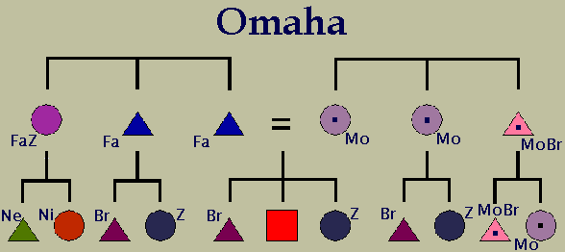
Kinship
Basic social behavior
Types of kinsmen
Kin terms and descent names
Omaha Indian kinship system
Notes:
The basic social behavior exhibited by mammals is seen between close kin.
Such sacrifice begins with a mother nursing her offspring and then extends outward, through her to her other offspring.
Humans everywhere have recognized that social behavior is based on kinship and have come to extend such sacrifice to distant kin, and in modern societies to non-kin.
Kinship relationships are based solely on birth, not on shared blood (metaphor) or genes.
A kinsman is someone who is linked by one or more birth links to oneself and therefore is either an ancestor (a parent or grandparent), a descendant (a child), or a co-descendant (one who shares a common ancestor, a cousin, aunt, or uncle).
So long as two individuals, living or dead, are identified as being either an ancestor, descendant, or a co-descendant, they are kinsmen no matter how distant.
People use various kin terms and family names to identify a wide range of relatives.
Kin terms (father, mother, son, daughter, cousin) imply a precise genealogical distance.
These terms allow us to identify a relatively limited set of close relatives.
Clan, ancestral, descent, and family names allow us to identify a much broader range of kin.
Ultimately, the function of all these names and terms is to identify individuals with whom we might cooperate or behave socially with.

Slide 16

Culture
What is culture?
Shared experience and knowledge?
Learned and copied behavior
Notes:
Culture and tradition is another behavior to emerge from kinship relationships, especially that between parent and offspring.
What is culture? How can we define culture?
A common definition says that culture is the accumulation of experience and knowledge.
However, neither experience nor knowledge is necessary for the existence of culture.
People (and dogs) on opposite sides of the earth can experience the same things independently.
A person who experienced ant stings in Africa wouldn’t make him of the same culture of someone who experienced ant stings here in the US.
In a similar vein, knowledge is not necessary for culture because we experience things independently.
The knowledge of Africans and Americans that standing in ant beds is painful does not make them part of the same culture.
Culture simply is any behavior that is learned and copied from any individual.

Slide 17
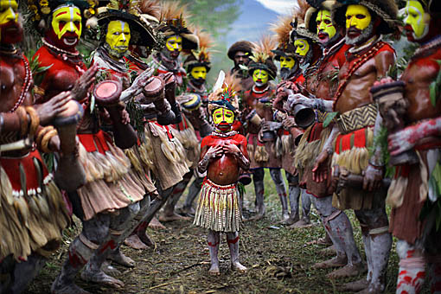
Tradition
What is Tradition?
Culture Acquired from Ancestors
Tradition and natural selection
Huli tribesmen in New Guinea
Notes:
For millennia humans and other animals chiefly learned and copied various behaviors primarily from their parents.
We are physically set up for this ability primarily because this behavior has helped our ancestors leave descendants.
Any cultural behaviors that are acquired from ancestors are called traditions.
Religion is a good example of a cultural tradition that is passed from ancestor to descendant.

Slide 19
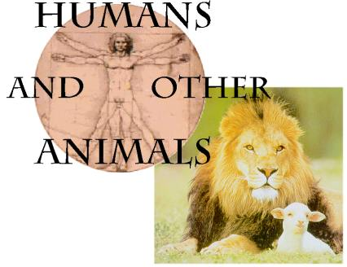
What Distinguishes Humans from other Animals?
Selfish appetites
Ancestral traditions
Essence of humanity
Notes:
What distinguishes humans from other animals is the suppression of selfish appetites through ancestral traditions.
Selfish appetite is the main cause of competition, conflict, and violence.
Ancestral traditions generally encourage social behavior among kinsmen through self-restraint and cooperation.
Although, like animals, humans are restrained by threats posed by other individuals, they actively encourage restraint and cooperation through traditions.

Slide 20
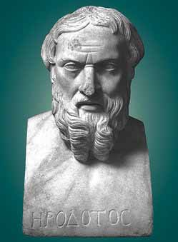
Social Origins of the Tradition of History
Religious roots
Not why, but how
Knowledge and the past
Descendant leaving strategy
Herodotus
Notes:
Religion and moral traditions especially encourage restraint and sacrifice for others at the expense of one’s own appetite.
I would argue that the discipline of history (originally part of religion) solely evolved from human’s capacity to pass traditions from ancestor to descendant and was originally aimed at encouraging restraint and sacrifice among kinsmen.
I think one would find a strong concern with restraint and sacrifice if they looked at the various tribal narrative histories, or the histories of the ancient world.
History didn’t originally come about to help us figure out why we have lived, but instead to show us (through our ancestor’s behavior) how to live.
Therefore, the reason why we have history was originally to show us how to live.
The discipline of history today should serve the same purpose: to teach us the lessons that our ancestors learned.
History is necessarily conservative because it seeks to conserve lessons learned by those who have gone before us. (but this does not necessarily mean conservative in the modern political sense)
It is part of a successful ancestral descendant leaving strategy that has persisted for a couple of million years.
There is a saying that those who don’t know history are doomed to repeat it.
This is true because those who don’t learn the history of their ancestors are more apt to make the same or similar mistakes their forebears did.

